Slide 1
Meeting House Matters
Leeds 18/07/2023

Slide 2
Meeting Houses Matter
Notes:
I love Meeting Houses for what they are and more importantly what they provide to the community around them.
They can and should be beacons of our worship and witness

Slide 3
Notes:
If we are to meet together in worship as the core of our being a Quaker community then we will need buildings to meet in.
Many of these buildings are and will continue to be owned by us as Quaker Meeting Houses.

Slide 4
Property Management Advisor
New post within Quaker Life
Broad remit
Only current national role on property matters
Split 3 ways:
Friends Trusts Ltd
Support to Meetings on Quaker property
Central property projects (Swarthmore Hall etc.?)

Slide 5
Friends Trusts Ltd
Custodian Trustee or Holding Trustee for most Area Meetings in England and Wales
Beneficial owners are the Area Meetings
Legal responsibilities, central point of contact for all (most) Quaker property
Also holds and manages investments for Area Meetings and other Quaker bodies

Slide 6
Property Advice
Support to Meetings on Quaker property
New post within Quaker Life
only 1 day/week!
Via Local Development workers
My previous experience…
Notes:
Me:
Civil Engineering degree
Masters in Energy and Environmental issues in the built environment
15 years as a building engineer and surveyor
17 years as manager of SWM/LQPT maintaining the 30 odd Meeting Houses in London - inc significantly improving the energy efficiency, building 2 new state of the art and building up reserves from 0 - £5m
Lifelong Quaker – Southampton, National and international.
Live in Hackney

Slide 7
Use
Maintain
Own
Wardenship
Quaker Life
MoMH e group
LDWs
Premises committees
Trustees
QQ reviews
Money
Improvements
access, eco …
Friends Trusts Ltd
Area Meeting Trustees
CIO
Future

Slide 8
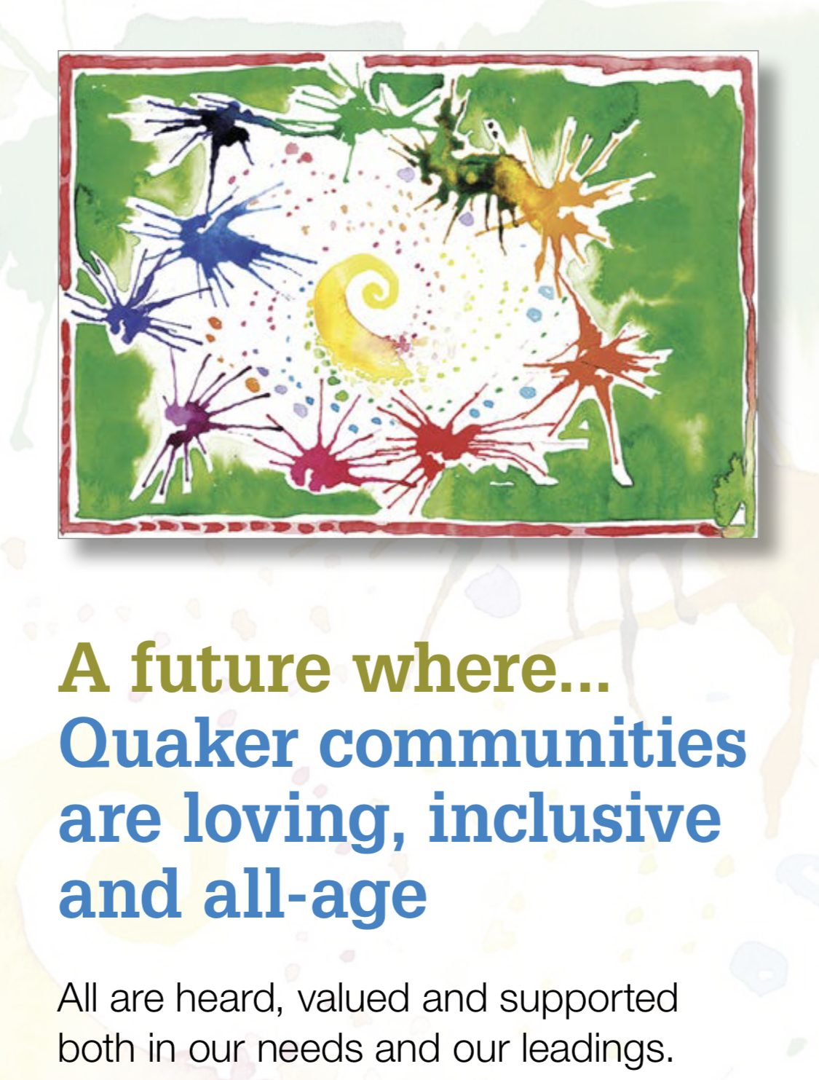
Notes:
How we own, maintain and use our buildings is intricately bound in to who we are.
These three are perhaps the most obviously connected to our MHs

Slide 9
Maintenance
Thinking about the Meeting Houses in your Area Meeting…
Are they the best they can be?
What might be holding them back?
Money
People – energy, interest
The building itself, history
Would you like to change that?
If so, what might be needed?

Slide 10
Ownership
Can you vision the Meeting Houses in your Area Meeting
In 10 -20 years?
Hopes
Fears
Ideas
Pathways to get there
Notes:
I love MHs and would like nothing more than to be helping create new ones
HOWEVER
I also am a realist and recognise that with our shrinking numbers since the 1960s we have too many buildings and will need to find other uses for many of them.
Sad but also a real opportunity.
Buildings are complicated and expensive and so take time to change.

Slide 11
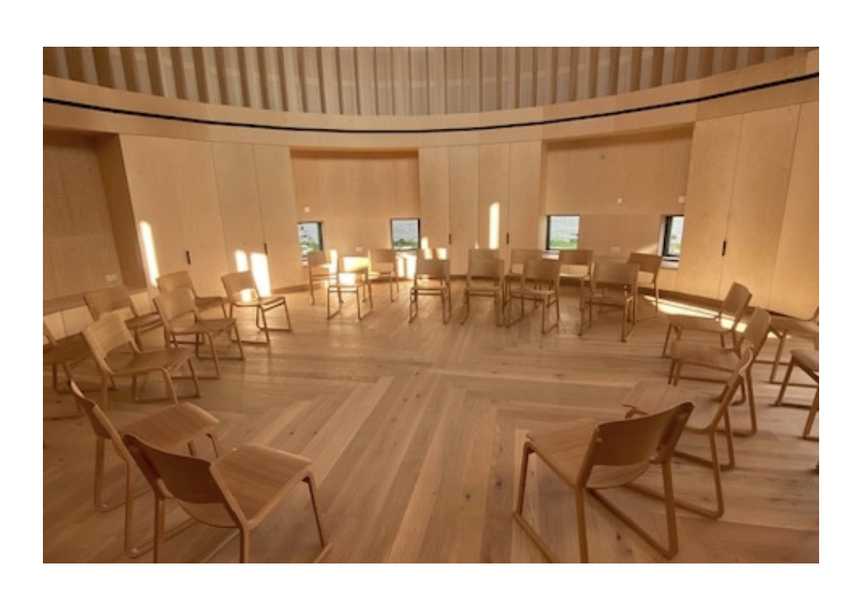
Worship Witness Work Witness Worship

